Slide 1

MAP-it
Brooke Carson & Mohammad Jamil
Web Application - Senior Project

Slide 2
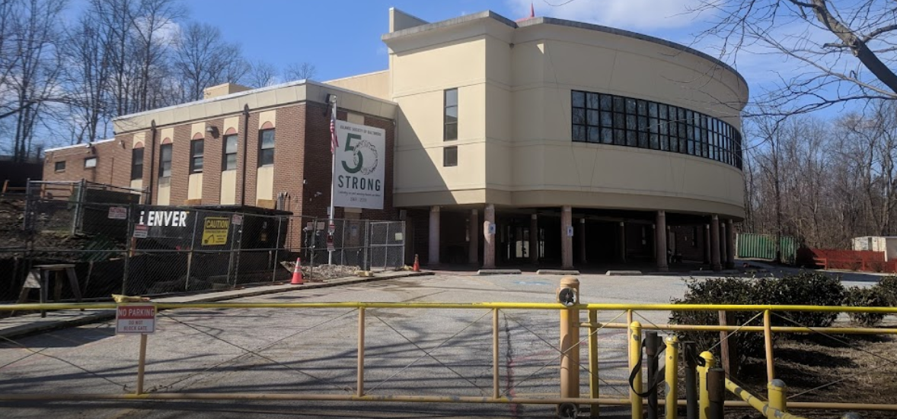

Project Overview
ISB located in Baltimore, MD
MAP has been dormant for past 2 years
Client has been an organizer for 6 years and is requesting a fresh, simple, and neat website to introduce events by the Fall of 2022
Flag football, Basketball, Karate, Baseball
Boys, Girls, Men, & Women

Slide 3
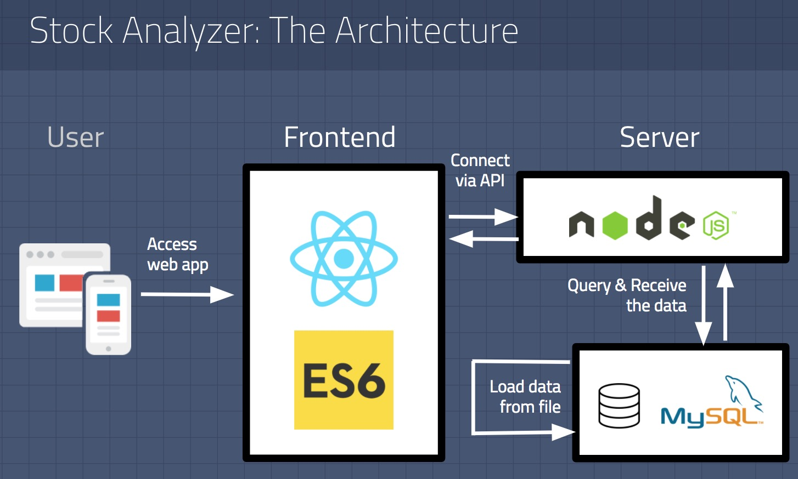
Technical Definitions
Front-End
Back-End
Node JS
MySQL Database
Testing
Mockito
JUnit (Branch Coverage)
React JS
Bootstrap

Slide 4
Functional Requirements
Admin
View/Create/Update/Delete Events
Manage live tracking during Events
View Calendar of Events
View Leagues, Tournaments, Camps
Register teams for events
Obtain registration codes
View live scoring updates of events
Media/Gallery showcase of previous events
Receive confirmation email after registration
Submit Contact Us Form that forwards an email to program organizers
View Frequently Asked Questions Page
View About us/Mission Statement

Slide 5
Non-Functional Requirements
Authentication with registration codes
Admin login authentication
Brand and color scheme
Black/Green/White color scheme
Logo already provided
Navigation usability
Secure communication between registration forms and databases
Mobile, Tablet, & Desktop Compatibility
Respond to requests timely, according to server
Live tracking updates every 20 seconds during events after admin has entered the updates
Automatic emails when a contact us form is submitted

Slide 6
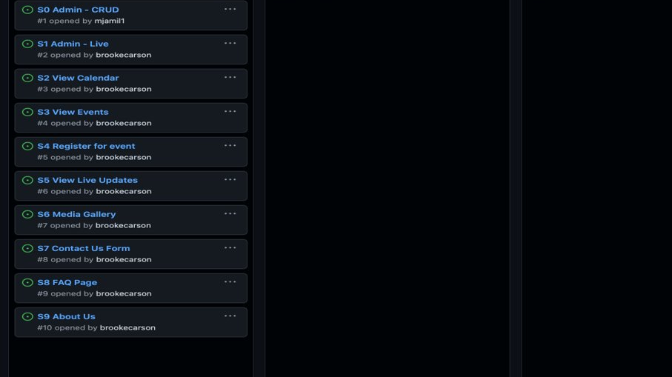
Kanban Board
More User Stories / Tasks will be added as development progresses
Will be utilizing the commenting function for code traceability

Slide 7
Inspirations
https://www.i9sports.com
https://www.volocity.org/baltimore/football/
https://www.aacounty.org/departments/recreation-parks/sports/team-schedules-standings/
Easy & Simple interface for accessing, registering, and viewing events
Well-organized scheduling
Inviting overlay

